Slide 1
DRL Seminar : Deep Learning and Neural Architecture
Part 2
Constantin Le Cleï

Slide 2
Outline
RL for Neural Architecture : Neural Architecture Search with Reinforcement Learning, Zoph et al., 2017
Neural Architecture for RL : Dueling Network Architectures for Deep Reinforcement Learning, Wang et al., 2016
Notes:
Want to emphasize on how Neural Architecture can benefit from RL, and how RL can benefit from Neural Architecture.

Slide 3
What is Neural Architecture Search
[Elksen et al., 2019]
Notes:
NAS is the process of automating the choice of architecture for a neural network. Recently, there has been a lot of interest in the field, with different strategies. A NAS method has :
search space that contains all possible architectures
search strategy which specifies how to explore the search space
performance estimation strategy : estimate the performance of a given architecture

Slide 4
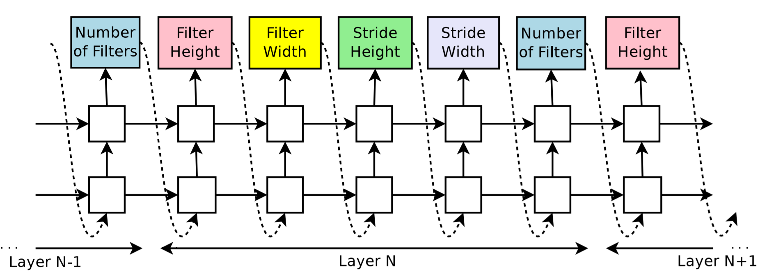
Neural Architecture Search with Reinforcement Learning, Zoph et al., 2017
RNN parametrized by THETA_C
[Zoph et al., 2017]
Notes:
At each timestep, the RNN generates a “token” which is a sample from a softmax distribution (the dimension of the output is the number of different values that this token can be chosen from) : for example, the stride width can be 1, 2, 3, etc…
This is only an example where the architecture generated is fully convolutional, can generalize it with different architectures.
How do we evaluate performance of the RNN? Here performance estimation strategy is the accuracy of the trained architecture on a validation dataset.
How could we modify theta_c so that the sampled architecture performs well ? The function that maps theta_c to the performance of the architecture is non-differentiable, and really complex, so the way to go is to use RL.
Say that it is not differentiable
Goal of NAS : find optimal hyperparameters of a neural network
Controller RNN, parametrized by to sample hyperparameters of each layer

Slide 5
RL Framework
At each timestep t, Agent : receives state S_t, performs action A_t, receives reward R_t
Actions, States and Rewards in NAS architecture ?
Notes:
Possibly receives reward R_t.
In the NAS case, it receives a single reward at the end, which is the average validation accuracy.

Slide 6
A_t
A_t +1
A_t +2
...
[Zoph et al., 2017]
Notes:
The previous action is given as input to the next timestep, so that current action depends directly on previous action, and indirectly on all the past actions through the current hidden state.
We are given the past hidden state and past action, so when we differentiate we only need to differentiate in the current timestep, not through time.
RL Framework with state is all the previous actions, and this state is contained in the previous hidden RNN state, and the previous action.
Each token defines P(a_t|a_t-1:1; theta). Together all the tokens define the joint probability P(a1,...,at)

Slide 7
Training
Objective :
Policy Gradients with Reinforce Rule
Monte-Carlo :
Notes:
P is the joint distribution over actions we make, so it is the probability distribution defined by the RNN.
R is the average validation loss(accuracy) at convergence.
We can evaluate J(theta) because we can sample from P, but how do we compute its gradient?
Use approximate method : Policy gradients with reinforce rule, this gives us the gradient of J, and we do a gradient descent step to update the parameters: do computation on black board
Can compute each gradient inside the sum with backpropagation (here the state is contained in the hidden state and the previous action, so no need for BPTT, only backpropagate through this column.
To compute each Rk, we need to train the network to convergence !
Can estimate the expectation with Monte-Carlo sampling : each k in the sum is an architecture that you have to train until convergence if you want to compute R_k.
The Monte-Carlo sampling can be done in parallel (all networks trained at the same time), but it stills take as much time as training a network to convergence, and this has to be done in every update step of theta.
So we want to parallelize the training of theta too.

Slide 8
Very long to train !
Accelerate training with Parallelism and Asynchronous updates
[Zoph et al., 2017]
Notes:
Model parameters are distributed among server shards
Controller replica fetches parameters from server, and send back gradients computed on child replicas
Update is done on server side, and server sends back updated weights
Draw the schema on black board. Say that it is called Downpour SGD. Each controller replica is assigned a subset of the training data. Each controller replica computes its update step using the average losses of its children and sends it to the server. The update of the weights of the controller RNN are done on the server side. You see that each controller replica computes different gradients since children are trained on different subsets of the dataset. This is what they call data parallelism.

Slide 9
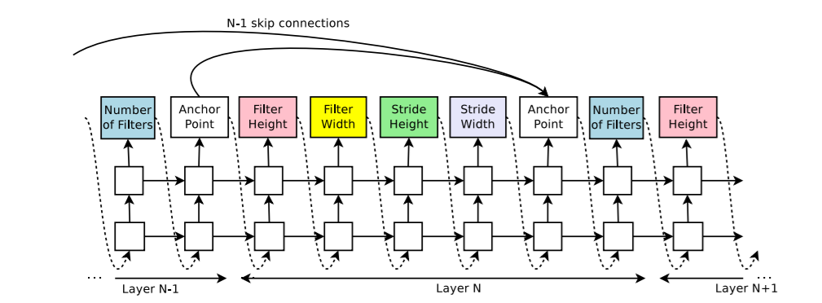
Increasing architecture complexity : Skip connections
[Zoph et al., 2017]
Set-selection attention (Bahdanau et al., 2015; Vinyals et al., 2015)
Notes:
Add anchor points between layers
We can still compute the gradient with Reinforce RULE since these probabilities
where v and W are trainable parameters
Each decision to connect(or not) two layers is an action and we can differentiate wrt this probability
Compatibility issues between layers can be taken cared of
Note that all those probabilities define actions, so we can still run REINFORCE.

Slide 10
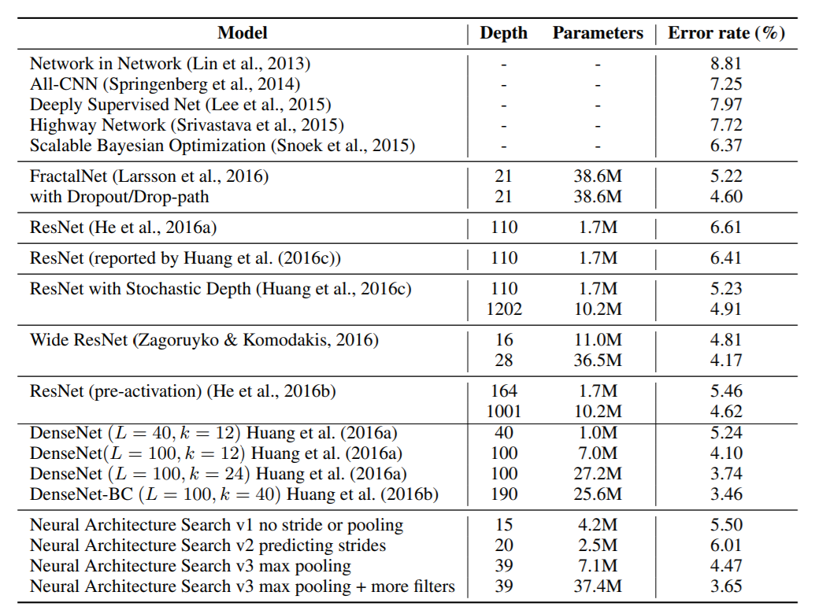
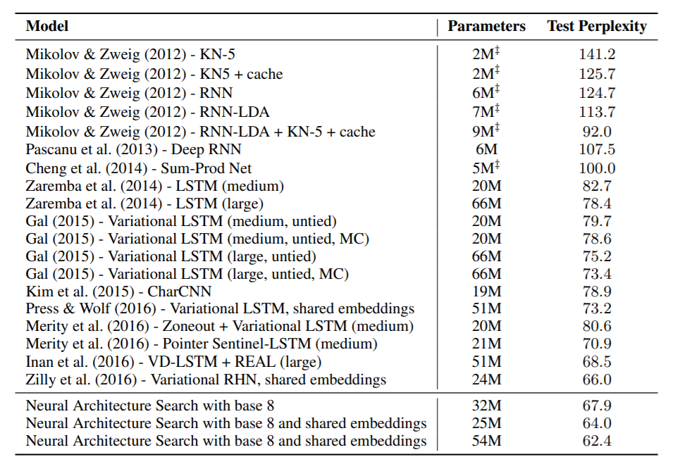
Results
CIFAR-10 dataset Penn Treebank dataset
[Zoph et al., 2017]
Notes:
Results on CIFAR-10 (Image classification dataset), Penn Treebank NLP dataset (using the previously shown recurrent cell architecture). It achieved performance just below DenseNet, which was state of the art at the time. On Penn Treebank dataset, it achieved state of the art at the time (2016),
with base 8 meaning that instead of a tree with depth 2, it uses depth 3. There the perplexity is a metric for NLP tasks.

Slide 11
Increasing architecture complexity : Recurrent cell
[Zoph et al., 2017]
Notes:
Given hidden state, cell state and input, specify how to connect them to output next hidden and cell states.
Can specify deeper connections using tree structure
Output of the tree is always the hidden state, and we specify the function of the cell state and its position

Slide 12
Neural Architecture Search with Reinforcement Learning - Conclusion
Use of RNN to generate architecture tokens
Can be trained with REINFORCE
Training can be speed up
Complexity can be increased
Notes:
Use of RNN to generate architecture tokens : Great compatibility between RNN and RL !
Can be trained, eventhough true objective function is no
Can speed up training with parallel and asynchronous updates
Complexity can be increased with skip connections or recurrent cell design

Slide 13
2) Dueling Network Architectures for Deep Reinforcement Learning, Wang et al., 2016
Background :
RL Goal : Maximize
State-Action Value, Value, Advantage functions
Notes:
Use a new neural architecture that is well-suited for RL, and use already existing DRL algorithms
Objective of RL : find optimal policy to maximize the total sum of rewards
In the previous paper, we had a reward at the end. Now this is classical RL case where we have a reward at each time step and want to maximize the discounted sum of rewards.
The discounted sum of rewards R_t
The agent acts according to a policy, in this case it is stochastic, which defines a probability distribution over actions in a given state.
s_t is just the past M observations concatenated together.
State-Action Value, Value, Advantage for given policy:
V = how good the current state is
Q = Value of a particular action when in a particular state
A = Relative importance of each action in this state
We also see that the Q value is the sum of the value and the advantage, where the value contributes the same way to every action.
The goal is to find the optimal Q function, because once we find it, we take the action with the maximum Q function, and this maximizes the RL objective.

Slide 14
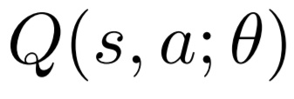
Goal : find optimal Q function
DQN (Mnih et Al.) : Approximate it with a DNN
Objective :
with
Notes:
The optimal Q function is the max over all policies of the Q value function.
Once we know this function, we know how to maximize the RL objective since at each time step we can just take the action with the maximum Q value, and this action will
also maximize the RL objective.
We approximate the optimal Q function with a DNN, which takes a state as input and whose output dimension is the number of actions.
At a particular timestep t, we define the loss, as expected over joint distribution of current state s, current action a, next reward r and next state s’ of the temporal difference between my current estimate
of the Q value and the sum of the reward I get + discounted maximum Q value of next state
We use max there because the Q value
theta- is the previous estimate of the parameters of the Q network, and we use it as a target for the current action.
This is the temporal difference rule, and it comes from Sutton [1988]. The intuition is that if I predict a certain reward at a particular time step, if that prediction matches the prediction made at the next timestep, it means it is likely to be correct since the next timestep is more likely to be correct in its own prediction than in my own timestep.
It can also be justified by the Bellman equation, which states
In practice, we cannot compute this expectation, because we don’t know the distribution over states and rewards.
So in practice, at each timestep t+1, we just evaluate this gradient on the state s_t, the action a_t, the reward r_t and the next state s_t+1,
so we approximate the expectation with just one sample. Then the gradient of Q can be computed with backprop.

Slide 15
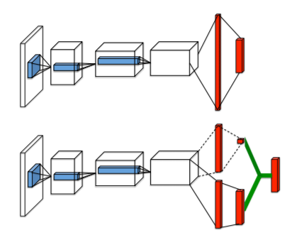
Duelling network architecture
[Wang et al., 2016]
Notes:
Now we know that we can find the optimal Q function, we also know that the Q function is the sum of the Value and Advantage functions.
So to get the Q value of a state, we add the value which does not depend on the action taken, and the advantage of a particular action.
For many states, it is unnecessary to estimate the value of each possible action choice. In some states, the action selection can be of great importance, but in many other states the choice of action has no repercussion on what happens next. Indeed, if the magnitude of the value function is really large compared to that of the advantage functions, the choice of action is irrelevant.
The top architecture is the traditional Q network, while the bottom one is the dueling architecture, where the upper stream estimates the value function, and the lower stream estimates the advantage function. At the last layer, we just sum them up. This green connection is a sum. So we still get the Q value as output, the forward pass is the same, but using 2 separate flows might help to learn a more accurate Q function.
Also, Features required to determine the value function may be different than those used to accurately estimate action benets, and computing the Q value, so using 2 different streams is profitable.

Slide 16
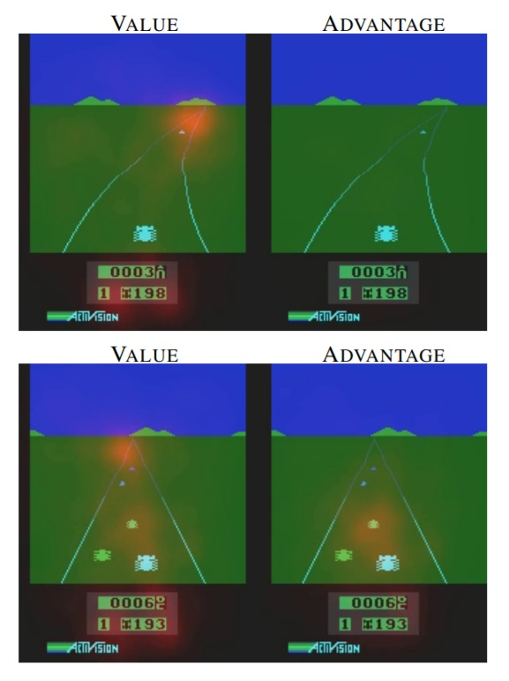
Duelling network architecture
[Wang et al., 2016]
Notes:
This is the Atari game Enduro, where the goal is to stay on the road and to avoid collisions with other cars. The images show the magnitude of the Jacobian of the Q value with respect to the image, after training.
We see that the value function learns to pay attention to the road, and that the advantage learns to pay attention only when there are cars immediatly in front, since in this case steering right or left is of great relevance, while when there are no cars any move is not of great importance since it can be corrected later.
Do on black board : Backpropagation
For standard Q network, at each timestep, the feedback signal passes through a single action, other actions remain untouched : for states where actions are irrelevant, this introduces bias and sparseness in actions
For dueling architecture, at each timestep, the value function is updated, and the feedback signal going through advantage function is lower and robust.
Say that for large action spaces, this effect is increased.

Slide 17
Enforcing V and A to be correct estimates
First try :
Instead :
For
Notes:
main problem with this simple design is that Equation (11) is unidentiable. Given q, we cannot recover v and A uniquely, e.g. adding a constant to v and subtracting the same constant from A gives the same Q-value estimates. The unidentiable issue is mirrored by poor performance in practice.

Slide 18
Results : Policy Evaluation
[Wang et al., 2016]
Notes:
As we increase the number of actions, duelling architecture performs better than traditional Q-network ⇒ Able to capture redundancies in actions

Slide 19
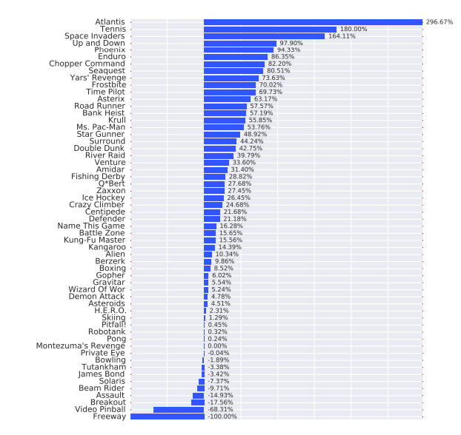
Results : General Atari Games
[Wang et al., 2016]
Notes:
The results presented in this paper are the new state-of-theart in this popular domain (in 2016)
Percentage of improvement in score between duelling and baseline/human performance

Slide 20
Dueling Network Architectures for Deep Reinforcement Learning - Conclusion
Learning State and Advantage
Efficient update of V
Better performance compared to single Q-network
State-of-the-art in Atari games (2016)
Notes:
Learning explicitly the state-value and advantage functions
Efficient learning of the state-value V, updated at every update of Q
Better performance compared to single Q-network architecture, especially when action space is large
Achieved state-of-the-art in Atari games at the time of publication (2016)

Slide 21
References
Large Scale Distributed Dense Networks, Dean et al., 2012
Neural Architecture Search: A Survey, Elksen et al., 2019
Playing Atari with Deep Reinforcement Learning, Mnih et al., 2013
Dueling Network Architectures for Deep Reinforcement Learning, Wang et al., 2016
Neural Architecture Search with Reinforcement Learning, Zoph et al., 2017

